Slide 1
Bullying
Together we can stop it

Slide 2
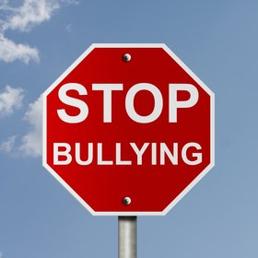
Anti-bullying week

Slide 3
What is bullying?
There are lots of definitions of bullying. However, it’s usually defined as behaviour that is:
intended to hurt someone either physically or emotionally
It is repeated. (It happens more than once).

Slide 4
What does it look like?
It takes many forms and can include:
physical assault
teasing
making threats
name calling
cyberbullying - bullying via mobile phone or online (eg email, social networks and instant messenger)

Slide 5
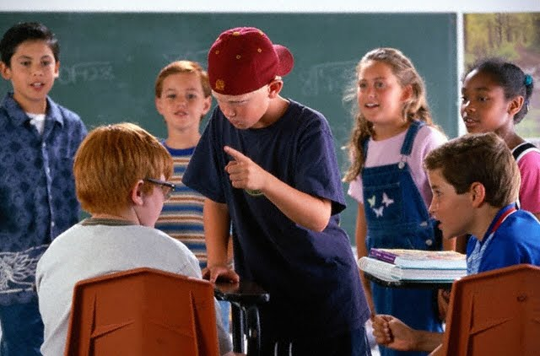
Who is involved in bullying?
The Bully
The Victim
Bystanders

Slide 6
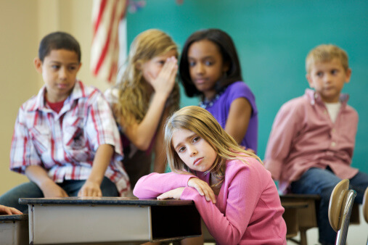
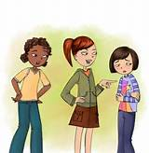
Who is who in these pictures?

Slide 7

Bystanders
Bullying situations usually involve more than the bully and the victim. They also involve bystanders—those who watch bullying happen or hear about it.
The bystander plays an important role.
Depending on how bystanders respond, they can either add to the problem or help find the solution.

Slide 8
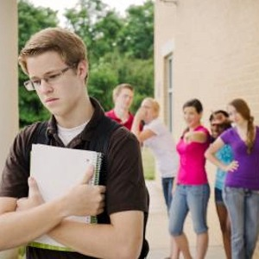
How can a bystander make it worse?
Some bystanders . . . instigate the bullying by prodding the bully to begin.
Other bystanders . . . encourage the bullying by laughing, cheering, or making comments.
And other bystanders . . . join in the bullying once it has begun by copying the bully.
Most bystanders . . . accept bullying by watching and doing nothing. Often without realizing it, these bystanders also contribute to the problem. Often a bully wants an audience these bystanders play that part.

Slide 9
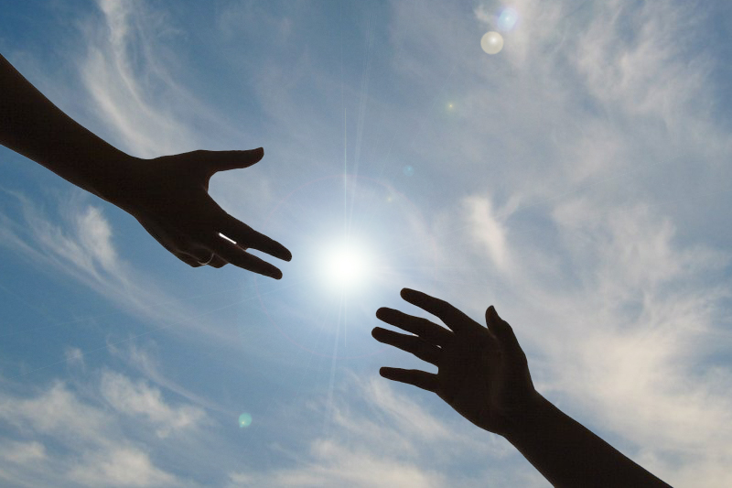
How can a bystander make it better?
Bystanders also have the power to play a key role in preventing or stopping bullying.
Some bystanders . . . directly intervene, by discouraging the bully, defending the victim, or redirecting the situation away from bullying.
Other bystanders . . . get help, by getting support from friends to stand up against bullying or by reporting the bullying to adults.

Slide 10
But I would be worried?
“It’s none of my business.”
I don’t want to get hurt or becoming another victim.
I feel powerless to stop the bully.
I think that telling adults won’t help or it may make things worse.
I don’t know what to do.
Nervous about speaking to anyone about the bullying
I feel guilty for not having defended the victim

Slide 11
Stand up, Speak out. Be a good friend.
Who wants to stop any bullying in our school? All these people agree with you.
Teachers will listen, tell them
Think of how you will make that persons life better

